Slide 1
CORPORATE GIVEAWAYS
PROPOSAL NOTES
Package:
Quantity:
Date needed:
Date needed to be shipped:
Special instruction to us:
SERVICES PROVIDED:
Gift Design
Individual packaging
Product Customization
Personal Notes
Drop shipping and distribution

Slide 2

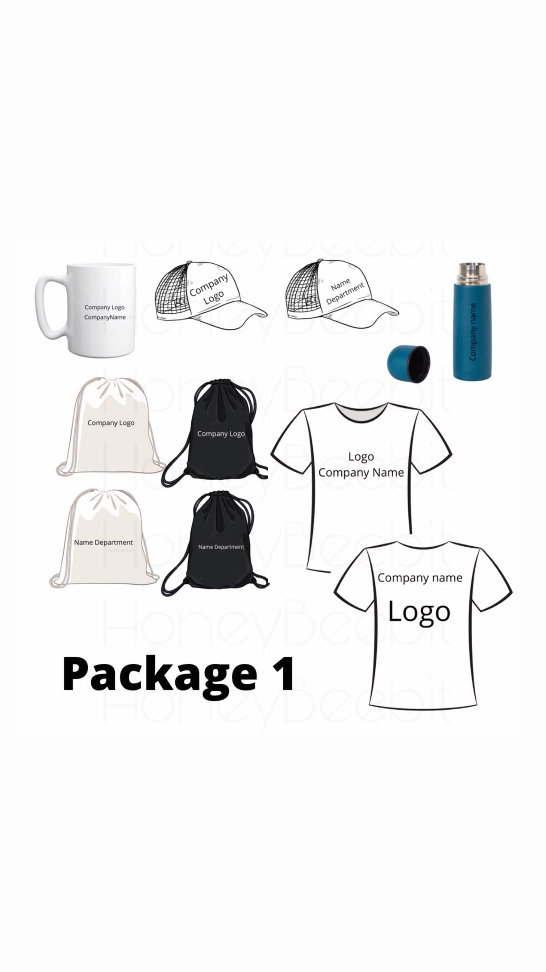
Package No. 1
Inclusion:
Subli mug
Net cap
Tumbler
Drawstring bag
Tshirt
Note: for print on dark shirt /canvas and other print size, Please provide /us a copy of your design for evaluation.
Price may be higher on dark colored shirts.
700 PHP

Slide 3
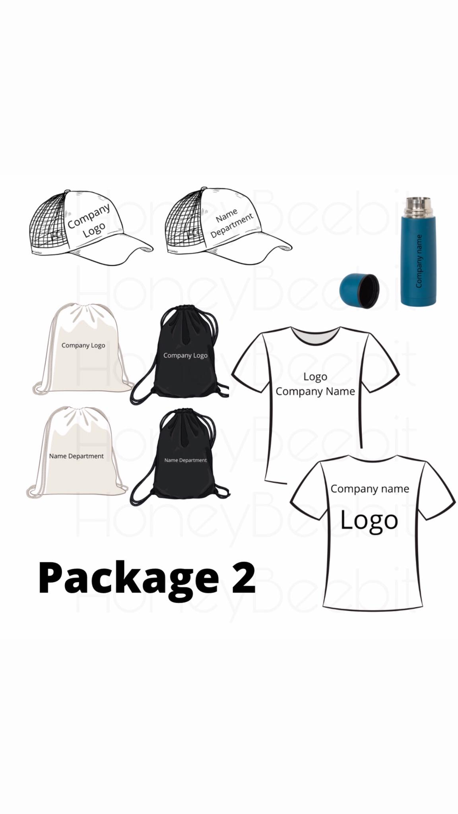
Package No. 2
Inclusion:
Net cap
Tumbler
Drawstring bag
Tshirt
Note: for print on dark shirt /canvas and other print size, Please provide /us a copy of your design for evaluation.
Price may be higher on dark colored shirts.
645 PHP

Slide 4
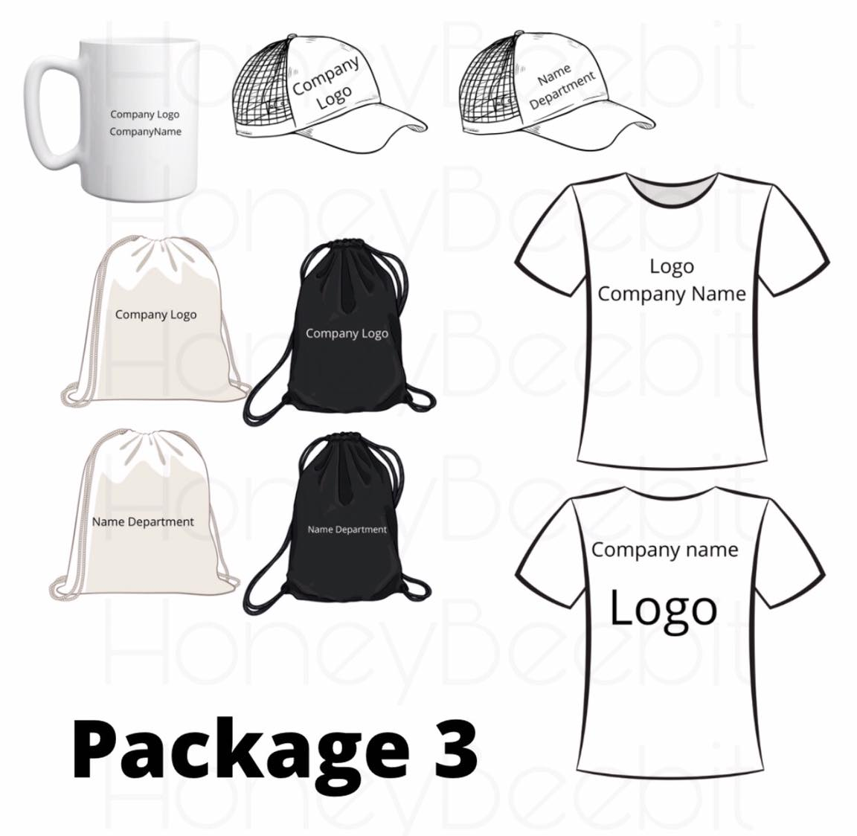
Package No. 3
Inclusion:
Net cap
Subli mug
Drawstring bag
Tshirt
Note: for print on dark shirt /canvas and other print size, Please provide /us a copy of your design for evaluation.
Price may be higher on dark colored shirts.
510 PHP

Slide 5
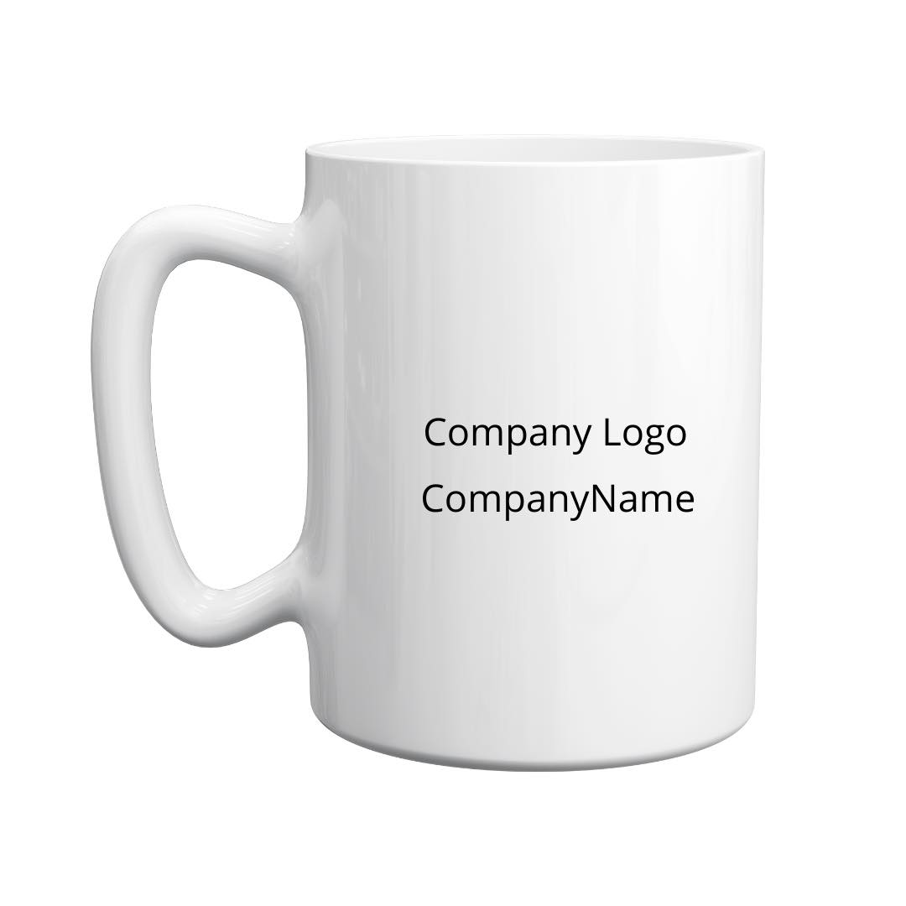
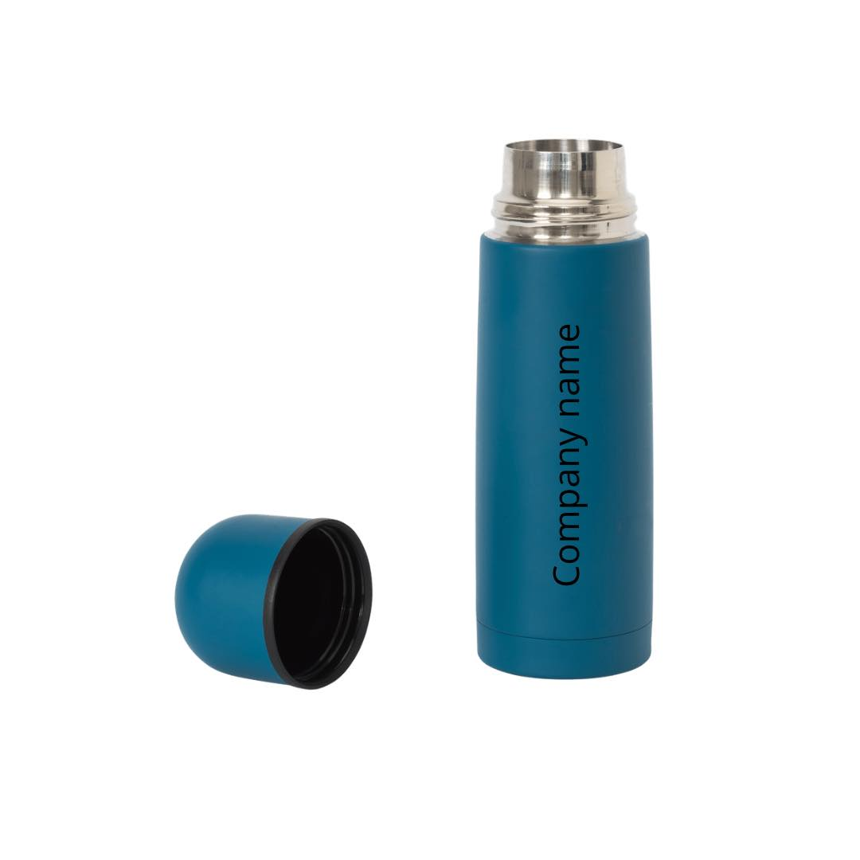
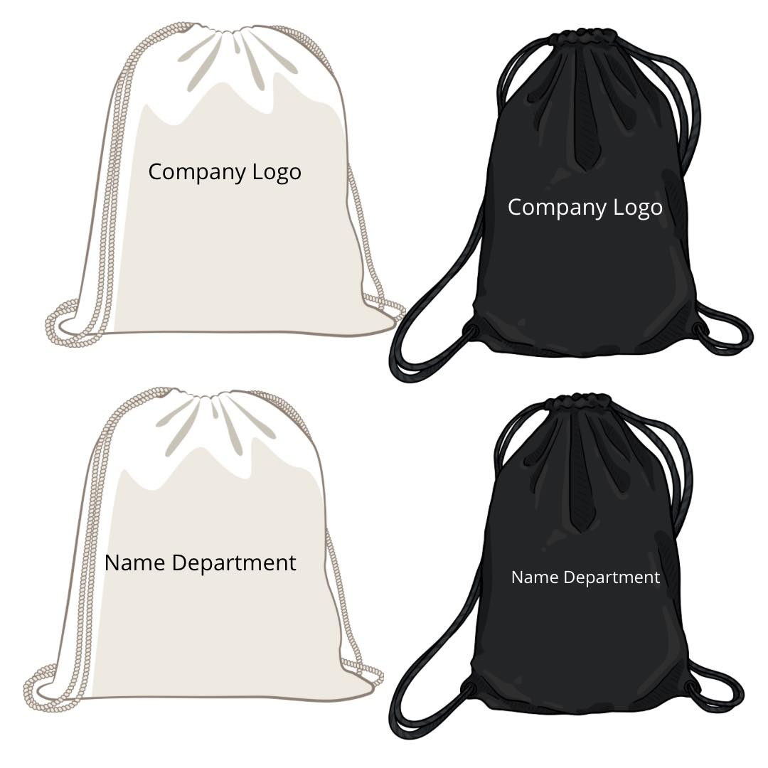

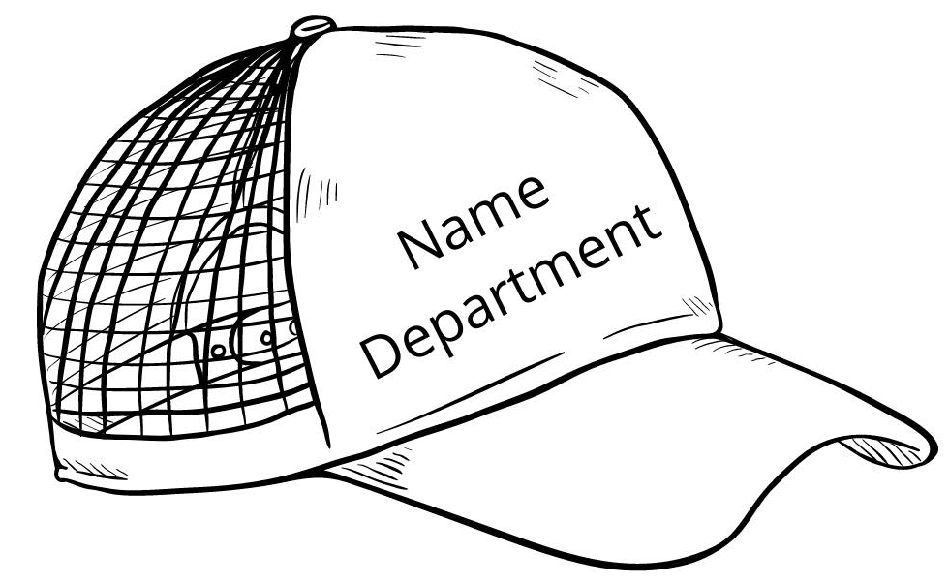
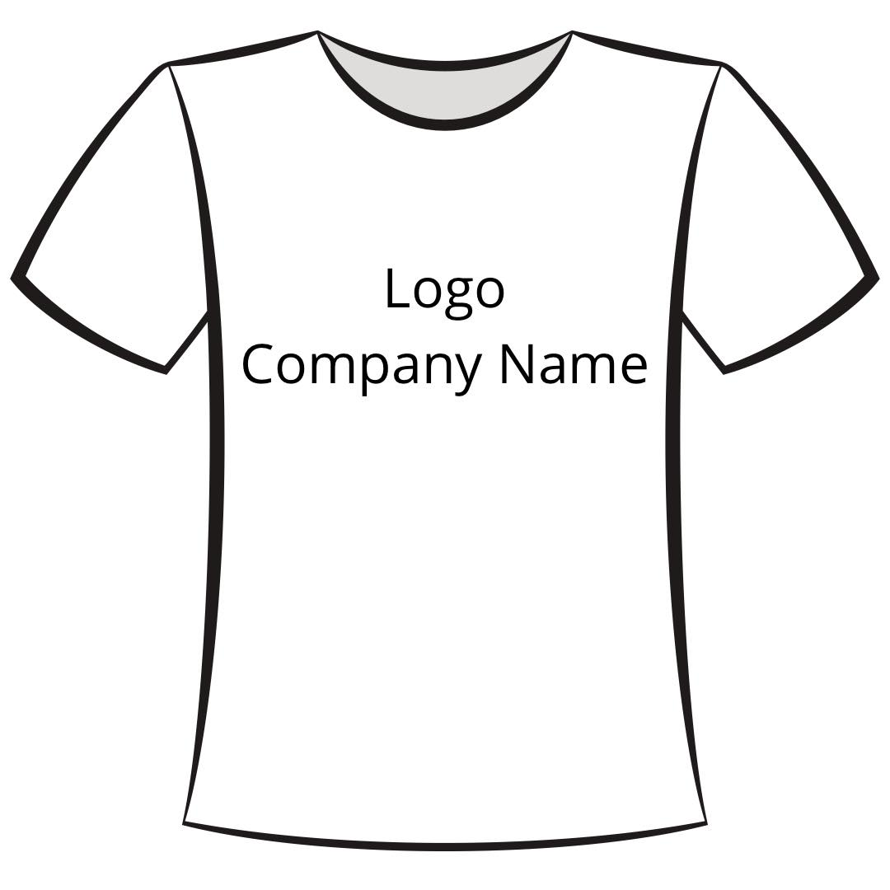
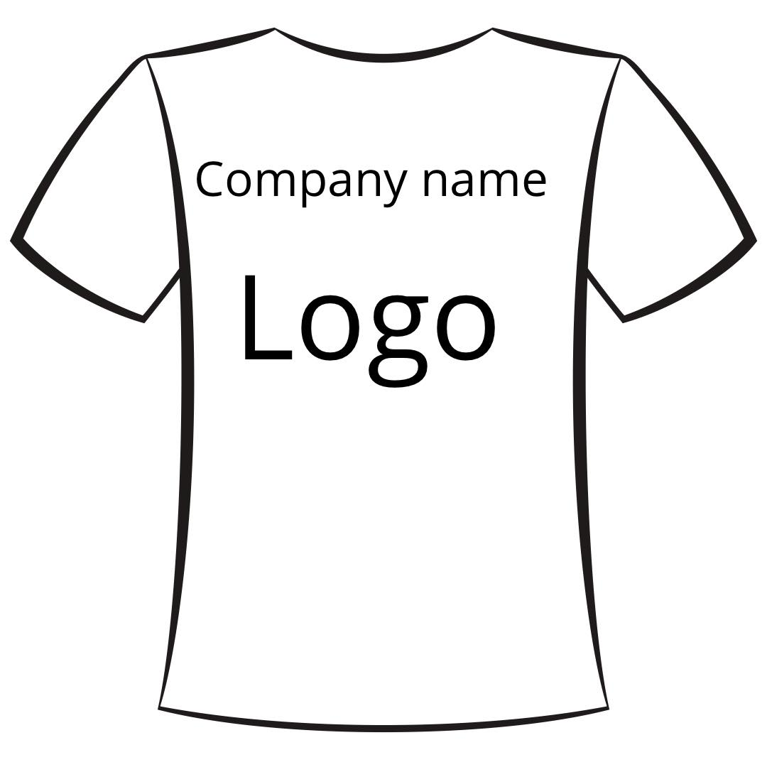


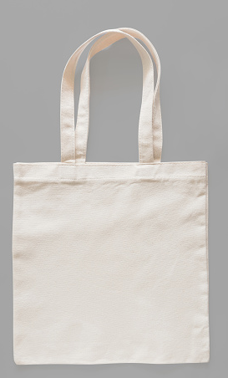
Others (minimum of 10PCS )
DRAWSTRING BAG CANVAS
150 php
Net cap
100 php
Mug
65 php
Tumbler
200 php
COMPANY LOGO
Tshirt
240 php
Paper bag
20 php
Face Towel embroidery
Company logo
300 php
COMPANY LOGO
Tote Bag Canvas
150 php
Note: for print on dark shirt /canvas and other print size, Please provide /us a copy of your design for evaluation.
Price may be higher on dark colored shirts.

